Slide 1
Building Blocks of Blockchain
Hyland Hy-Tech Camp

Slide 2
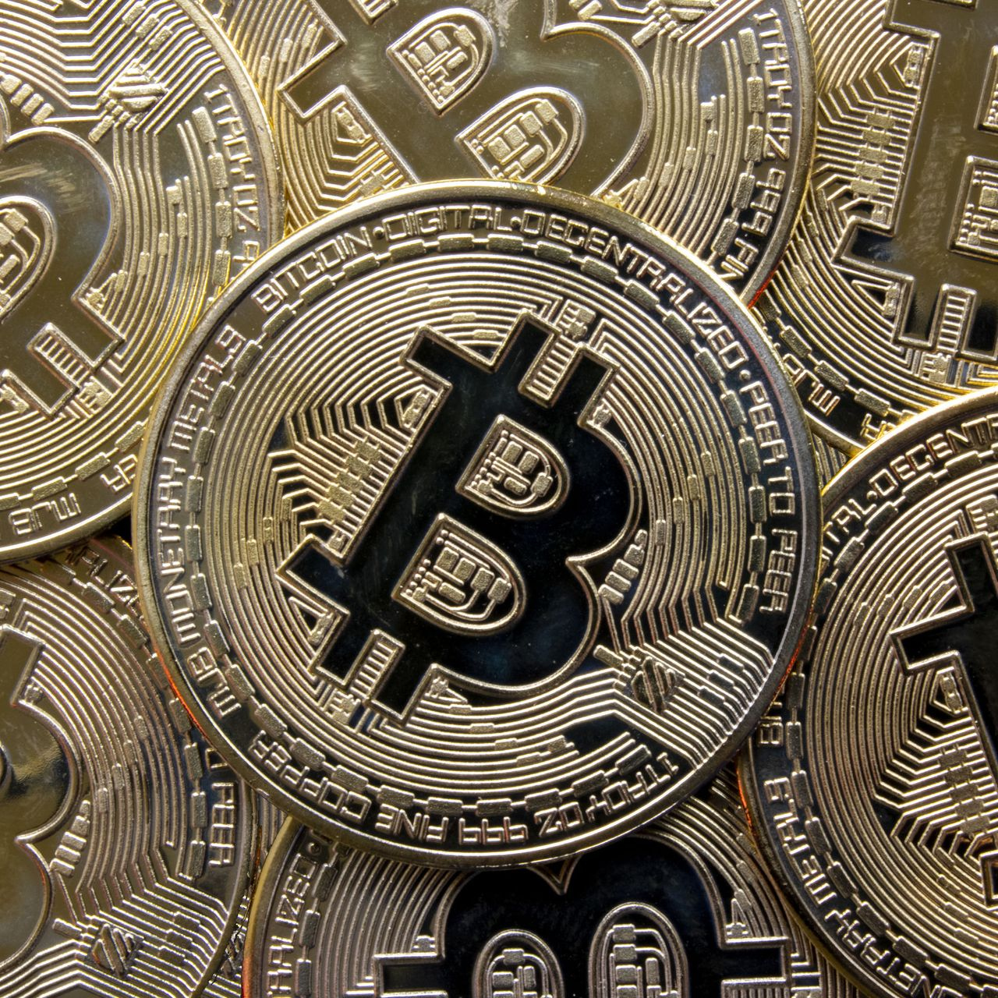
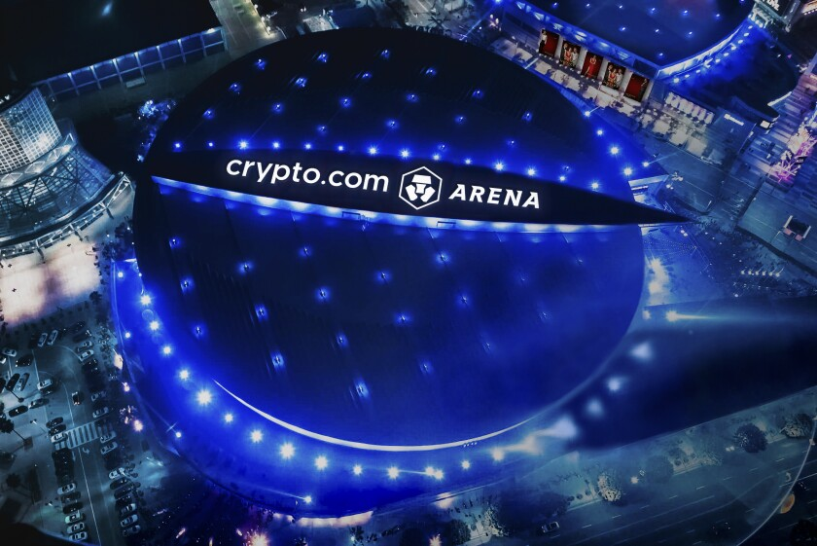





Cultural Perceptions
Notes:
Poll the room to see how many students have heard of blockchain, bitcoin, cryptocurrency, NFTs
Ask the students if they know what these things are
Bitcoin is a Cryptocurrency – you might have heard about it as an investment.
Ask if students recognize this shiba inu – it’s the mascot of a memecoin called Dogecoin.
Does anyone know where the Lakers play? They used to play at the Staples Center, but the name recently changed to crypto.com.
You may have seen the Matt Damon super bowl ad for the same company – it’s a Cryptocurrency exchange.
Maybe you’ve seen this FTX ad featuring Steph Curry – or maybe you recognize the ice sculpture he’s building (Bored Ape Yacht Club NFTs)
You may have seen pictures like this pixelated person – they are NFTs, basically digital assets than can be owned and traded.
Another example of NFTs is NBA Top Shot – basically virtual trading cards

Slide 3
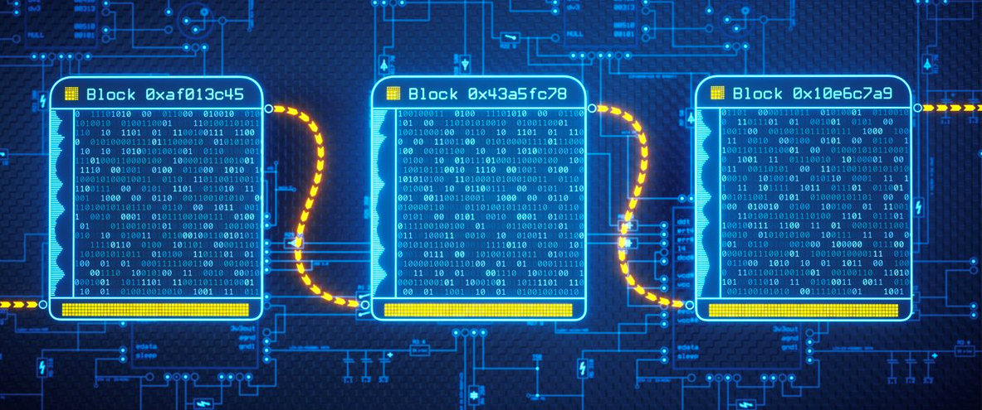
Blockchain: The Technology Behind It All
A blockchain is a distributed, immutable ledger for recording transactions and tracking assets
It is the technology behind cryptocurrencies and NFTs
Although it became popularized with Bitcoin, its applications are much farther reaching
Notes:
Go over the definition of blockchain – this will be covered more in-depth later on, so no need to over-explain
Important keywords: Distributed and Immutable
Blockchain is the underlying technology that makes things like cryptocurrency and NFTs possible
Was popularized with Bitcoin (more on that later), but there is a lot more that it can do

Slide 4
The History of Blockchain
Where does it come from?
Notes:
Get into some of the history of blockchain – if students remember from the previous slide, it was popularized with bitcoin

Slide 5
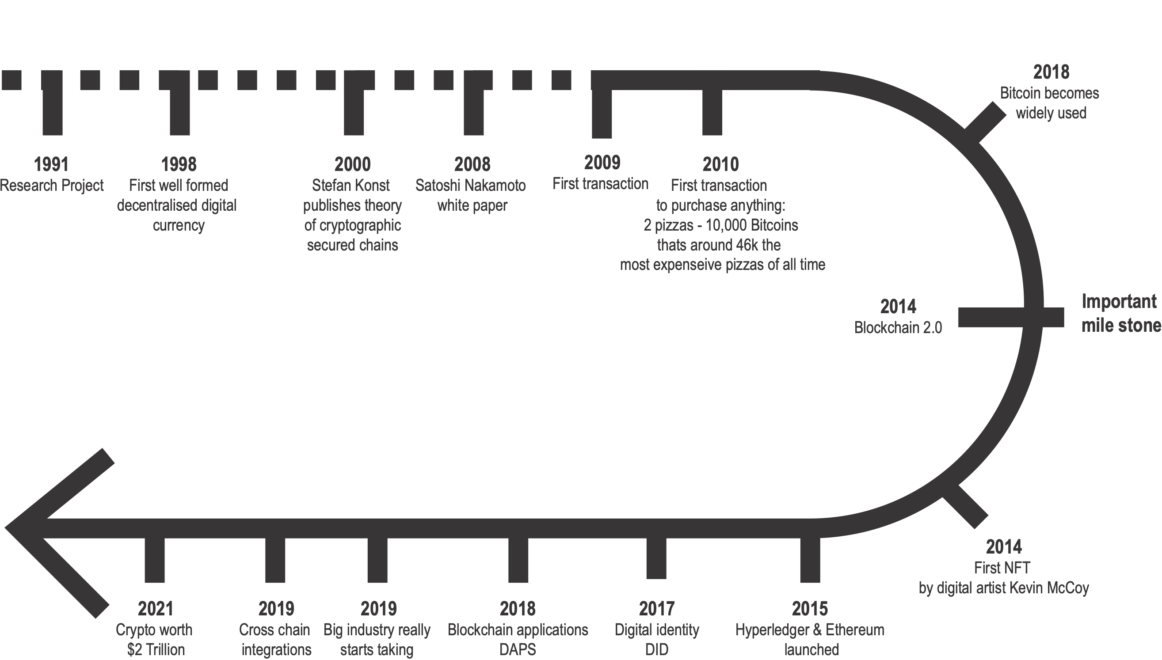
Timeline
Notes:
`<click>` This is a rough timeline of the history of Blockchain. We'll talk a bit more about some of these, but what we want to highlight here is the beginning of all of this. In 1991, a research paper discussed A cryptographically secured chain of blocks for the first time.
In 1998 a computer scientist worked on 'Bit Gold', a decentralized digital currency.
In 2000, a theory was published on how to cryptographically secure chains of data.
2008 leading into 2009 was then the start of Bitcoin, which started the era of blockchain.
2014 was then the start of seeing uses for blockchain outside of only currency.
Ask if there are any questions `<click>`

Slide 6
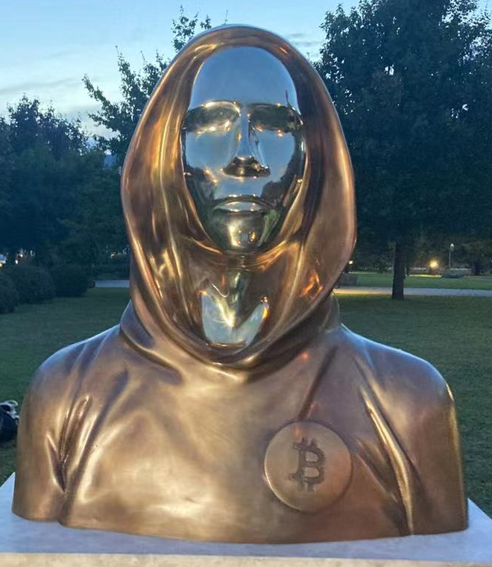
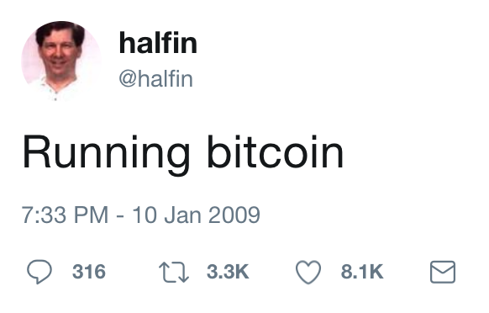



Bitcoin & Satoshi Nakamoto
What is a cryptocurrency?
A digital currency designed to work as a medium of exchange through a computer network that is not reliant on any central authority, such as a government or bank, to uphold or maintain it.
How did it start?
Jan 4, 2008 – bitcoin.org registered
Oct 31, 2008 – white paper posted
Jan 3, 2009 – genesis block
Who is Satoshi Nakamoto?
Hal Finney
Dorian Nakamoto
Nick Szabo
Notes:
Ask the students what they think a cryptocurrency is
Reveal the definition, and call out the key points – it’s a digital currency, and it’s decentralized
Go through some of the early events – how it all began
Jan 4, 2008 is when the domain name was registered
Halloween 2008 is when a mysterious whitepaper appeared, authored by a pseudonymous person (or group of people) named Satoshi Nakamoto
This whitepaper contained the technical details involved in implementing the first ever blockchain – upon which bitcoin would be based
It was posted to a cryptography mailing list
The identity of Satoshi is still unknown to this day – there are some people it might be:
Hal Finney, first receiver of a Bitcoin transaction – tweeted “Running bitcoin on 10 Jan 2009”
Dorian Nakamoto (born Satoshi Nakamoto) – probably just a coincidence
Nick Szabo – stylometric analysis (i.e., writes in the style of the bitcoin whitepaper), published a paper on “bit gold” (precursor to bitcoin)
Could be a group of people
We will probably never know
Whoever Nakamoto is, on Jan 3, 2009, the Bitcoin genesis block was created

Slide 7
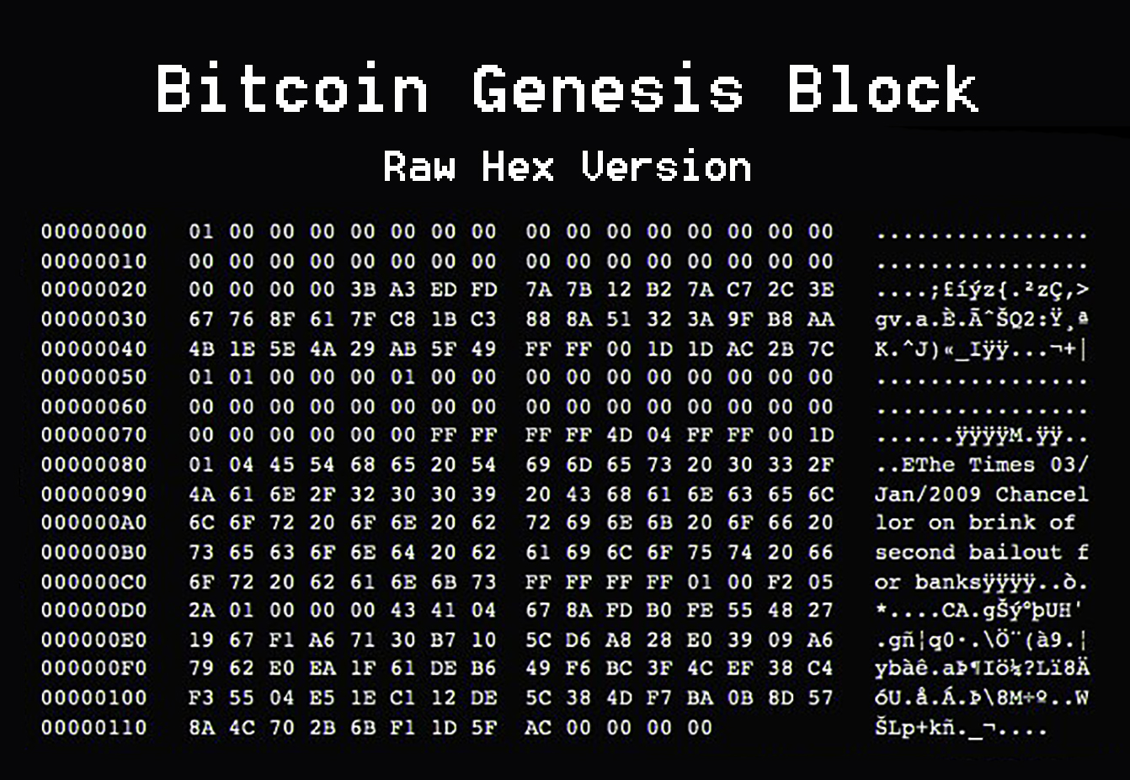
Jan 3, 2009 – Blockchain Arrives
Bitcoin block number 0
50BTC ($1.5mil in 2022)
Not-so-hidden message
Why use blockchain?
Trustless
No central authority
Like physical cash
Secure, immutable
Open source, grassroots
Notes:
The “genesis block” for a blockchain is simply the first block mined (or, block number 0)
The reward for mining this block was 50 BTC (or about 1.5 million in 2022)
Ask the students if they can find the hidden message in the block
“The Times 03/Jan/2009 Chancellor on the brink of second bailout for banks” – referring to a headline from a newspaper about banks
Ask the students why they think Nakamoto would put this in the block
The message could give us a hint to Nakamoto’s identity, and definitely to his motive
Get into some of the “why” of blockchain
As opposed to big banks that can be unstable, Nakamoto may have believed that the trustlessness of blockchain would be better
Bitcoin would not have a central authority – this is meant to give individuals more power
It could act kind of like digital “cash” – peer-to-peer spending, without identity needed
We’ll get into it a bit more, but security was a big part of it
Many early adopters were in the cryptography space – the entire technology is based on cryptography, which is a big part of security
The immutability of the ledger means that all transactions will live forever, and can always be traced
It’s open source nature led to a focus on community-driven development – individual people, working together to create something new
It’s kind of inspiring that they did this in such a grass-roots way!
https://www.investopedia.com/news/what-genesis-block-bitcoin-terms/

Slide 8
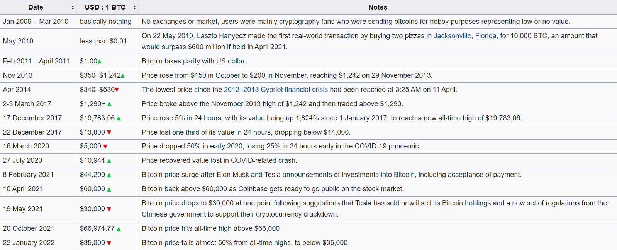
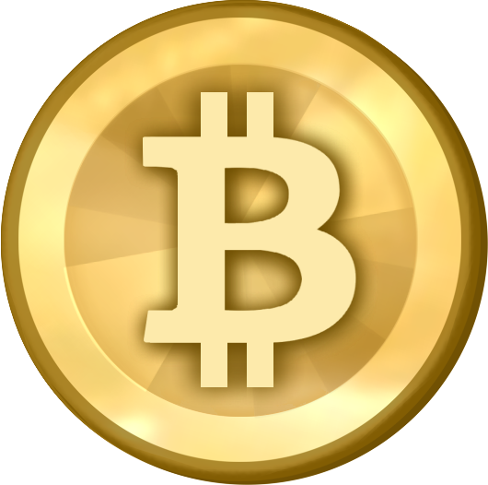
Bitcoin Value History
Date
Jan 2009-Mar 2010
Value in $
basically nothing
Notes
No exchanges or market, users were mainly cryptography fans who were sending bitcoins for hobby purposes representing low or no value.
Notes:
https://en.wikipedia.org/wiki/History_of_bitcoin
Talk about the growth of bitcoin and how blockchain technology grew along with it

Slide 9

Bitcoin Value History
Date Value in $
May 22, 2010 Less than $0.01
Notes
Laszlo Hanyecz made the first real-world transaction by buying two pizzas in Jacksonville, Florida, for 10,000 BTC, an amount that would surpass $680 million if held in November 2021.
Notes:
https://en.wikipedia.org/wiki/History_of_bitcoin

Slide 10
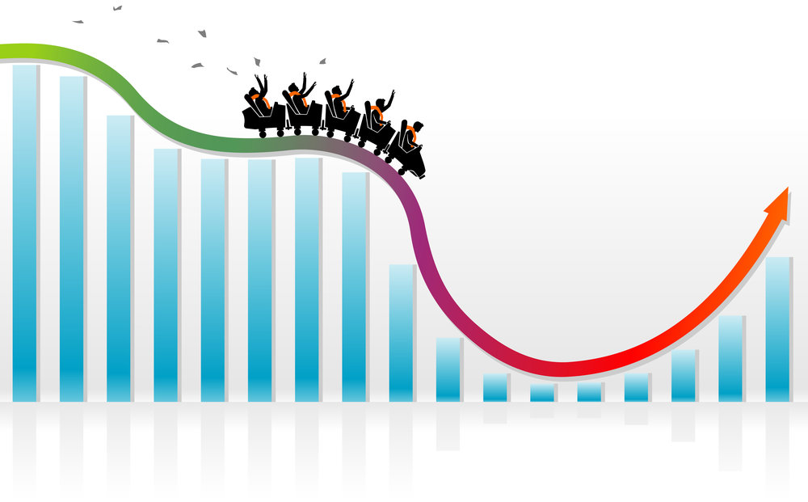
Bitcoin Value History
Date
Nov 2013-Present
Value in $
Extremely Volatile
Notes
Financial Crisis
COVID-19
Elon Musk/Tesla
Coinbase
Other Factors?
Notes:
https://en.wikipedia.org/wiki/History_of_bitcoin
Mention that in the present, El Salvador has bitcoin as a national currency (for better or worse)
VOLATILE

Slide 11




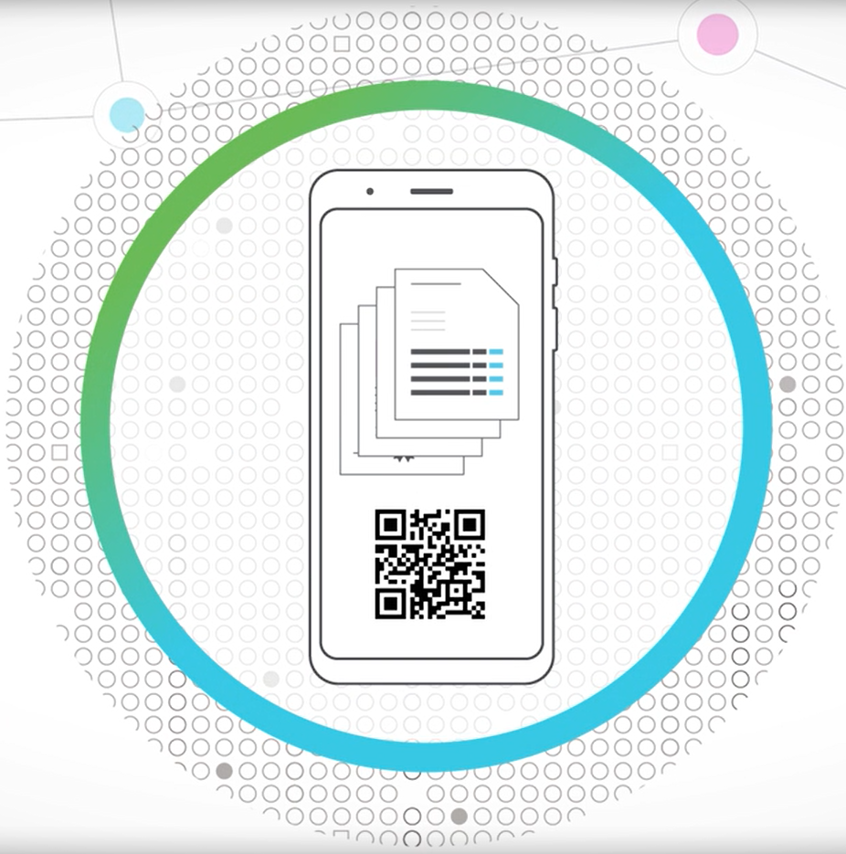
Blockchain Beyond Bitcoin
2014: Blockchain 2.0
More widely available
Investment from companies like IBM, Microsoft
Dapps
Decentralized applications
Back-end code does not run on a central server
Data integrity, privacy, built-in payments
NFTs
Non-fungible tokens (unique)
Digital ownership (spec assets)
Thousands of Cryptocurrencies
Tether – Stablecoin
Dogecoin – Memecoin
Ether – Smart contracts
Hyland Credentials
Government of Malta – nationwide initiative for education certificates
Notes:
2014 was the beginning of what’s known as “Blockchain 2.0” – basically moving beyond the basics of a cryptocurrency
It became more widely available as a technology
There was investment from companies like IBM and Microsoft
Since around then, there have been a lot of new cryptocurrencies (thousands, in fact)
One interesting one is Tether – it’s what’s known as a “stablecoin” – its value is meant to be tied to another currency
And of course, there are memecoins like Dogecoin – which has had some ups and downs
There is also Ether (Ethereum’s cryptocurrency) – the big thing there was that it introduced smart contracts (we’ll talk more about that later)
One thing Ethereum does is power Dapps
These are decentralized applications
Instead of back-end code running on a central server, it runs on the blockchain
Dapps have features like data integrity due to the immutable nature of the blockchain, privacy/anonymity/security, and built-in payments using Ether (Ethereum’s currency)
They are often things like token swaps, games, and investments
Another technology powered by blockchain is NFTs
Non-fungible tokens – each one is completely unique
It’s a way to basically own something digitally… ex, anyone can buy a Monet print (download a jpeg), but only one person can own the original (have the nft)
They are kind of like digital trading cards, but only one exists
Could be used to verify ownership or creatorship of art, music – preventing plagiarism
Can also be used for scams and just speculative value
One final example here – Hyland Credentials is Hyland’s blockchain-backed credentialing technology
The government of Malta is a customer – they used this technology to issue education certificates across the country
Falsifying student transcripts is an issue, and this helps with automation
There are other uses too, like supply chain management, food contamination tracking, and more. This is just scratching the surface!
https://www.oreilly.com/library/view/blockchain/9781491920480/ch02.html
https://www.hyland.com/en/platform/product-suite/hyland-credentials/higher-education

Slide 12
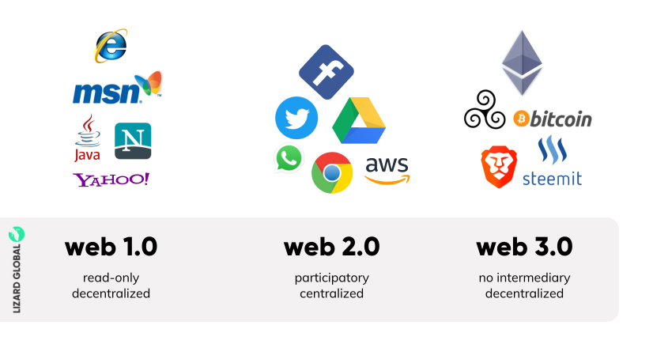
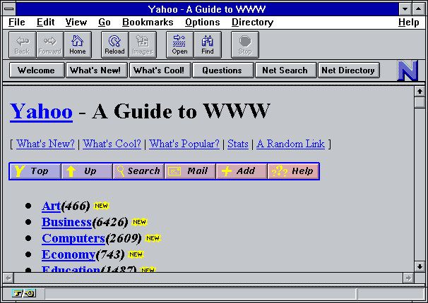
Blockchain & The Web
Notes:
Now let’s talk a little bit more about some history… this time, the history of the internet
The internet started with web 1.0 – websites like msn and Yahoo
It was “read-only”, meaning most web patrons were simply consumers – they would look at what the “dweebs” had created
It was also decentralized, because all the sources of information were scattered and controlled by various parties
Here is a picture of what Yahoo used to look like – as a consumer, you would just click on links and dig through content!
https://www.martechalliance.com/stories/whats-the-difference-between-web-1.0-web-2.0-and-web-3.0

Slide 13
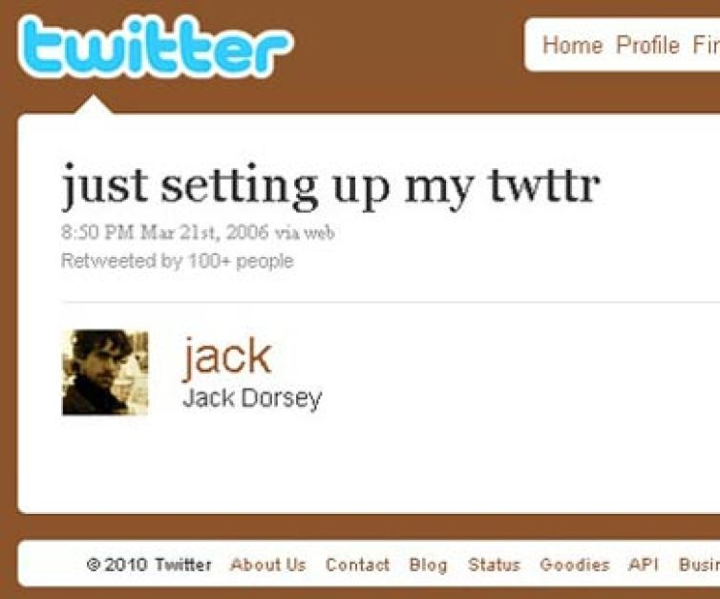
Blockchain & The Web
Notes:
In recent memory, the internet has been in web 2.0 – websites like facebook and services like aws
Now, the web is “participatory” – anyone can create content, and most of what you view is created by regular old consumers just like you
It is also centralized – all of the data pretty much resides in a few key places (like on facebook’s or google’s or amazon’s servers)

Slide 14
Blockchain & The Web
web 3.0
Value – built-in commerce capability
Identity – one single source of truth
Persistence – the ledger is immutable
Tech – AI, Metaverse, De-Fi, NFTs, IoT
Notes:
The next phase is web 3.0 – here, the innovations of blockchain create a new landscape of development
No intermediaries are needed, because everything is on the blockchain
It is decentralized – no central authority to govern what can and can’t be on the internet – it’s just the people!
Let’s dive a little deeper into web 3.0 – what are some of its features?
Value – built-in commerce based on crypto
Identity – one single source of truth for identifying individuals
Persistence – because the blockchain is immutable, everything online will persist, and censorship should not be an issue
Tech – some technologies that will be involved in this are artificial intelligence, metaverse, decentralized finance, and nfts
One interesting idea from Web 3.0 – you could use blockchain and IoT technology to create a digital identity used to unlock your car!

Slide 15
Blockchain Architecture
How does a blockchain actually work?
Notes:
Now we’ve talked about the origins of blockchain – let’s get into how the technology actually works.

Slide 16
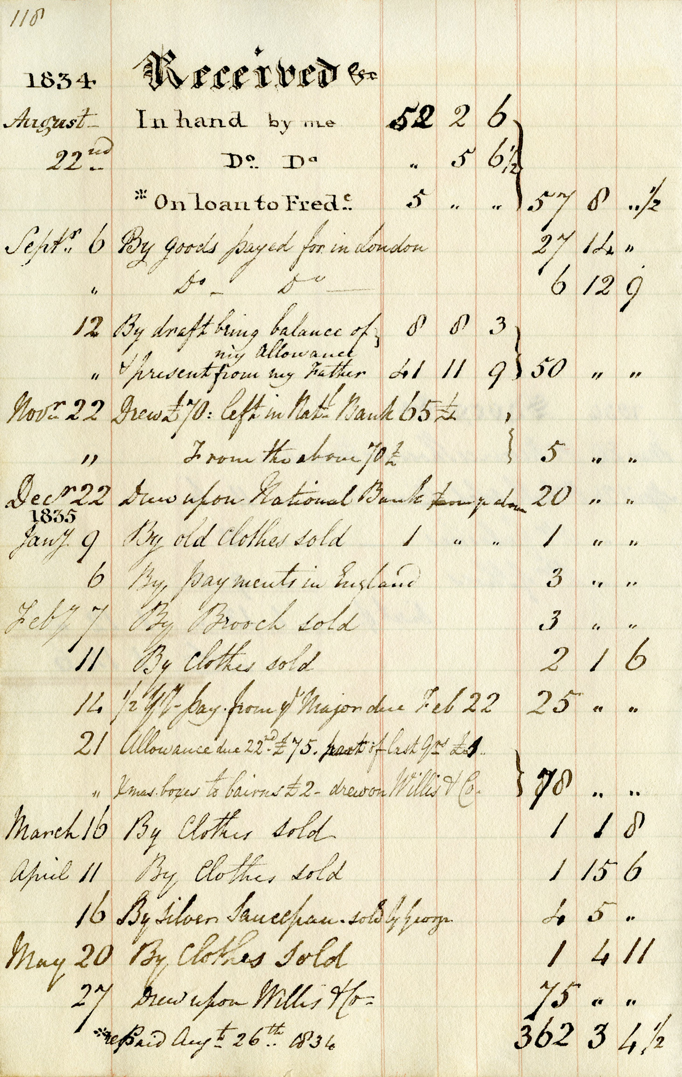
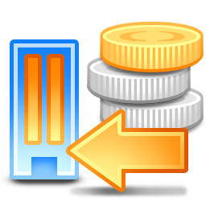

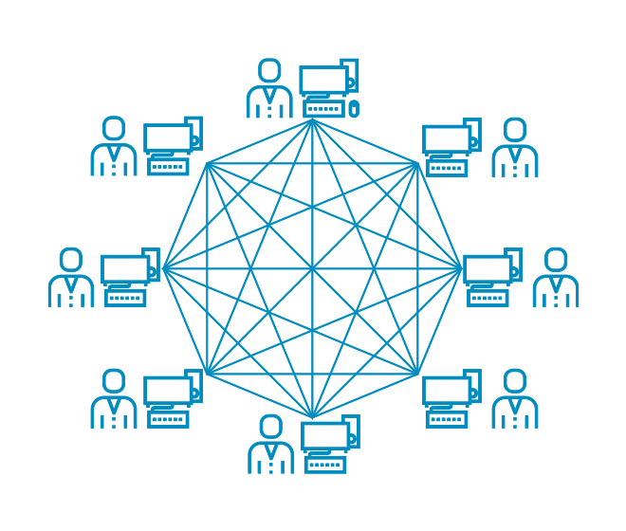
Key Elements
Ledger
A place to track transactions
Transactions
Transfers of assets between addresses
Stored on blocks
Blocks
Chained together
Verified via cryptography by the network
Network
Distributed into nodes
Each node (computer) has a copy of the ledger
Nodes build consensus to confirm the transactions
Notes:
Let’s first cover some of the key elements. These concepts are crucial to understanding blockchain.
A blockchain is a ledger – put simply, a place to keep track of transactions.
Ledgers have existed since before computers as a way to keep balances on accounts
Blockchain ledgers are:
immutable (meaning they stay around forever)
distributed (meaning there are multiple copies)
secured by cryptography
Transactions are transfers of assets between addresses
Just like when you buy something at a store – that’s a transaction!
At a grocery store, they keep that in their company records. On blockchain, it’s there for all to access
These transactions are stored on blocks
Blocks contain groups of transactions
They are chained together, each block storing an identifier for the previous block
They are verified, or signed, using a cryptographic function to ensure they are secure
The network keeps track of all the blocks
The network is distributed, meaning every node (computer) on the network has a copy of the blockchain
These nodes use a consensus algorithm to determine the source of truth
https://www.youtube.com/watch?v=bBC-nXj3Ng4
https://jis-eurasipjournals.springeropen.com/articles/10.1186/s13635-019-0085-3
https://consensys.net/knowledge-base/a-blockchain-glossary-for-beginners/

Slide 17
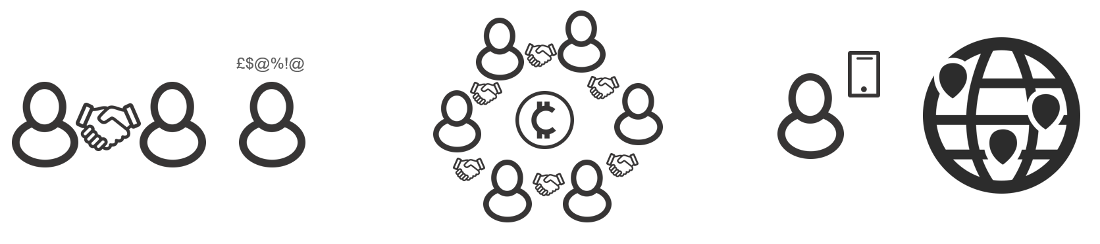
Unplugged Example
Everyone
1 Person
3 People

Slide 18

Mining with Cryptography
A miner is a Block creator/signer who receives a Block Reward (₿₿₿)
PoW (Proof of Work) – a verification system in which a miner proves that a LOT of computational effort has been expended
More than would be worth faking – this helps build consensus
Nonce (number used once) – magic number that miners want to find
Makes the block hash fit the pattern
Cryptographic Hash Function – takes data and outputs a random-looking string of letters and numbers called a hash
For the hash to be valid, it should start with many 0s
Easy to verify, but extremely difficult find (1 in 75 sextillion chance)
Notes:
This slide has some nitty-gritty info that can be glossed over – it does inform the interactive activity quite a bit though.
Ask the students if they’ve heard of cryptocurrency mining – do they want to get rich?
You probably can’t actually get rich without a sizeable investment in computing hardware… let’s talk about why
A miner is the person who gets the “Block Reward” – basically the person who verifies that a block is legit
They also often get transaction fees
Why would someone believe a miner when they sign a block?
Proof of Work is one method
The miner proves that they did a LOT of work – the key is that faking this work would not be worth it… harder to fake than to just do the work itself
This helps build consensus – the other nodes know they can trust the block, at least tentatively
So how do they prove they did a bunch of work? They are looking for a magic number called a nonce that is VERY hard to find
This magic number makes the block hash fit a certain pattern
What’s a hash? This is from cryptography and often used in security
This function takes some data (e.g., blockchain block) and outputs a string of letters and numbers called a hash
It looks random – but it’s not! The hash is always the same for a given input
The hash has to fall under a specific pattern – for example, in bitcoin, it has to start with a bunch of 0s
For this to happen randomly would be a 1 in 75 sextillion chance – but it’s easy to verify a correct hash for the block
It’s okay if this doesn’t make a lot of sense yet – let’s get into the interactive demo\
https://bitcoin.stackexchange.com/questions/1781/nonce-size-will-it-always-be-big-enough
Difficulty: https://bitcoin.stackexchange.com/questions/16687/solo-mining-just-for-luck-realistic

Slide 19
Interactive Demo
andersbrownworth.com/blockchain/
Notes:
Briefly walk through the different parts of this demonstration, and have the students play with the interactive tool as well. There is a video walking through it on the main page, but don’t show that during the presentation. The different demos are available from the top right menu.
Hash: Enter any data, and it will create a random-looking string – that’s the hash. Note that it’s the same for every message the same time – but drastically different with small changes
Block: Now, there’s some extra things:
Block number – don’t need to modify that
Nonce – this is the magic number that makes the hash work
Mine – this button will find the appropriate Nonce for the data
Change the data, see it turn red when the hash changes, press the mine button, see it turn green when the hash changes
Blockchain: Now, with multiple blocks, each one keeps track of the previous hash
Changing one way back will invalidate the whole blockchain – this leads to the immutability
Distributed: imagine hundreds of these – all mostly the same – it should be fairly easy to catch any one node trying to go and mess with anything
A 51% attack, where 51% of the network teams up to steal stuff, is possible – but unlikely
Tokens: Bringing it back to the currency idea – instead of tracking arbitrary data, now the blocks store transactions
Coinbase: This is where the block reward comes in – miners generate entirely new currency when they create blocks
This is the only place currency is generated – all other exchanges are simply trading coins that have been created already
Note that no transactions can take place that overdraw anyone’s balance – the only way to spend coin is to have it first
Encourage students to watch the videos and play around with the tool later – there is also a part 2

Slide 20
Ethereum & Smart Contracts
How can you develop a blockchain app?

Slide 21
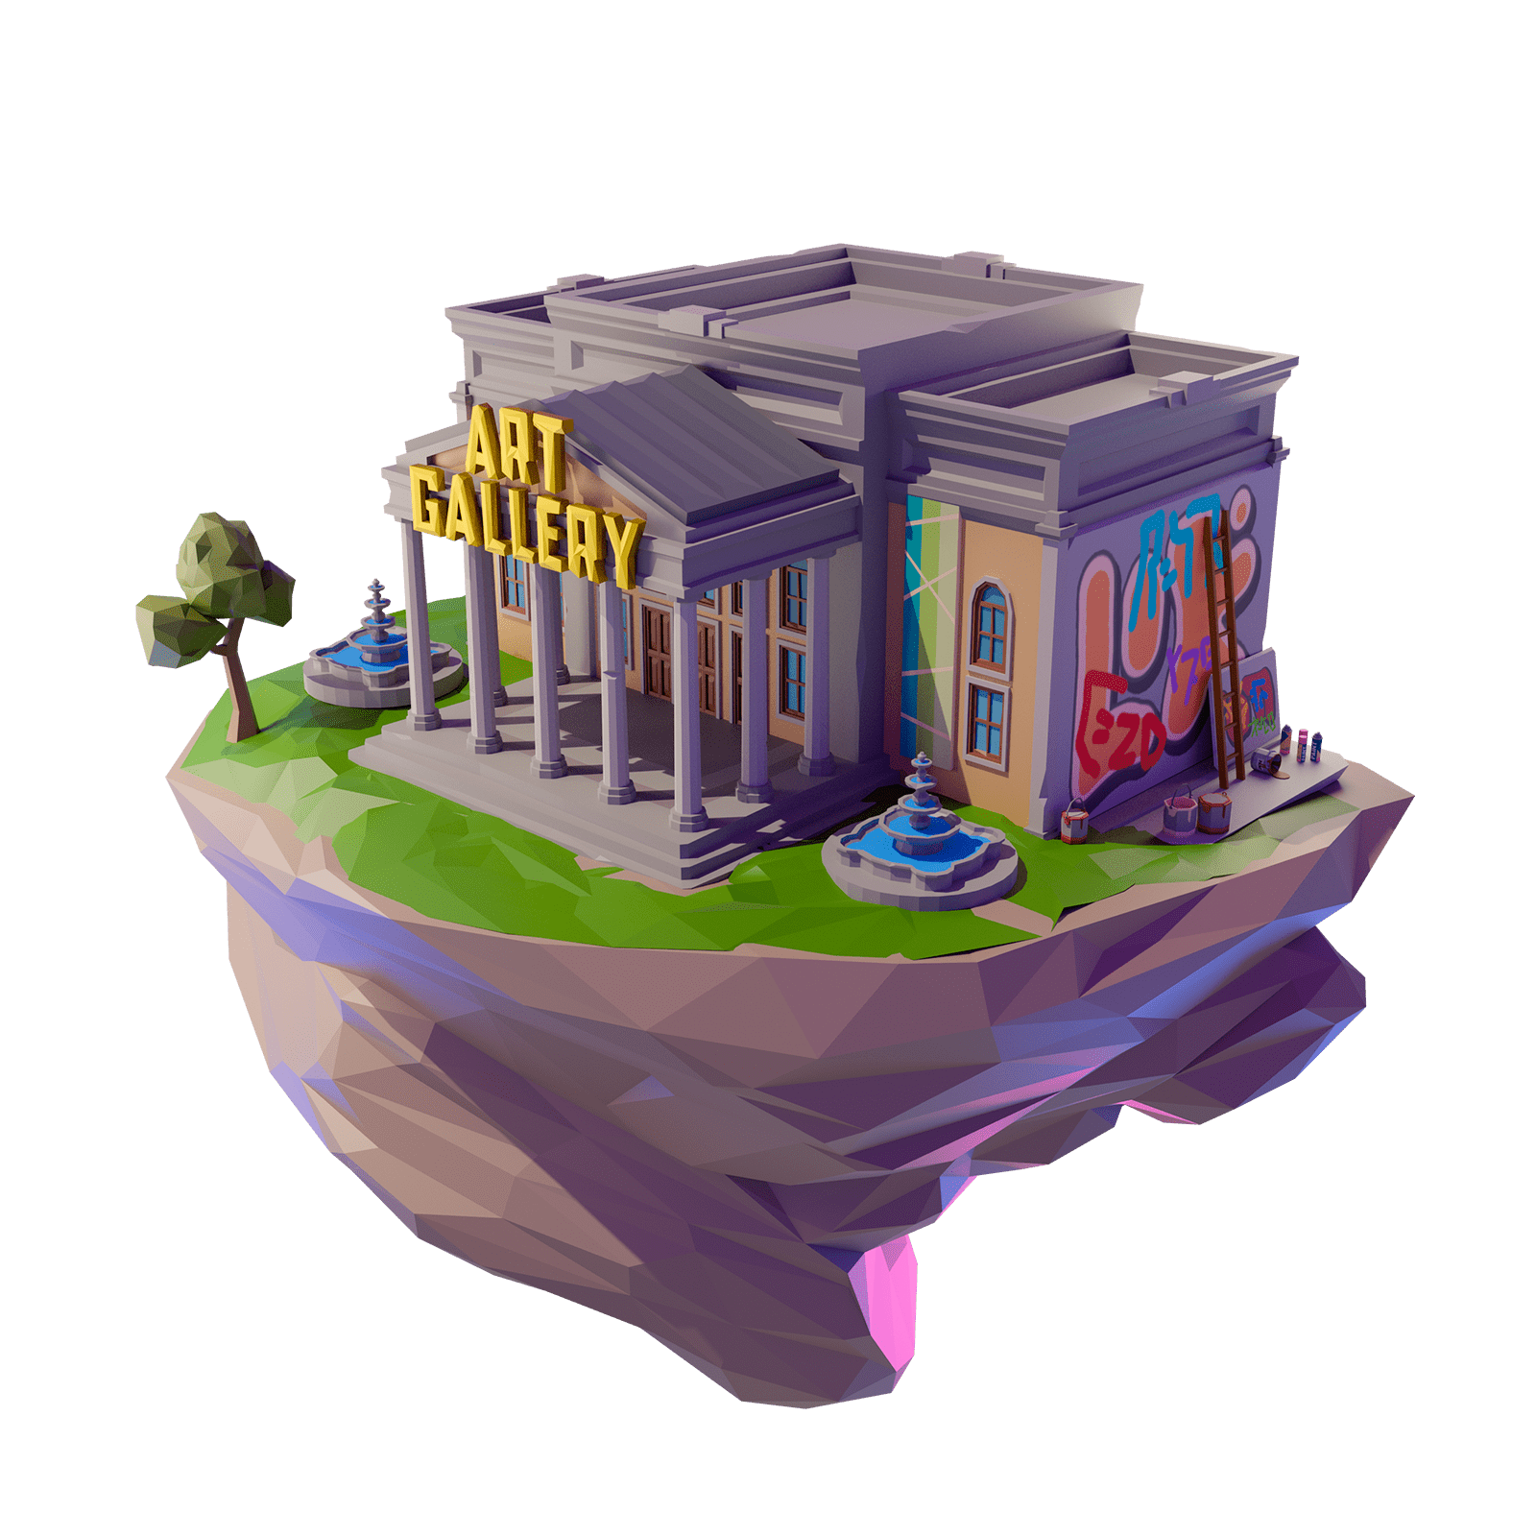


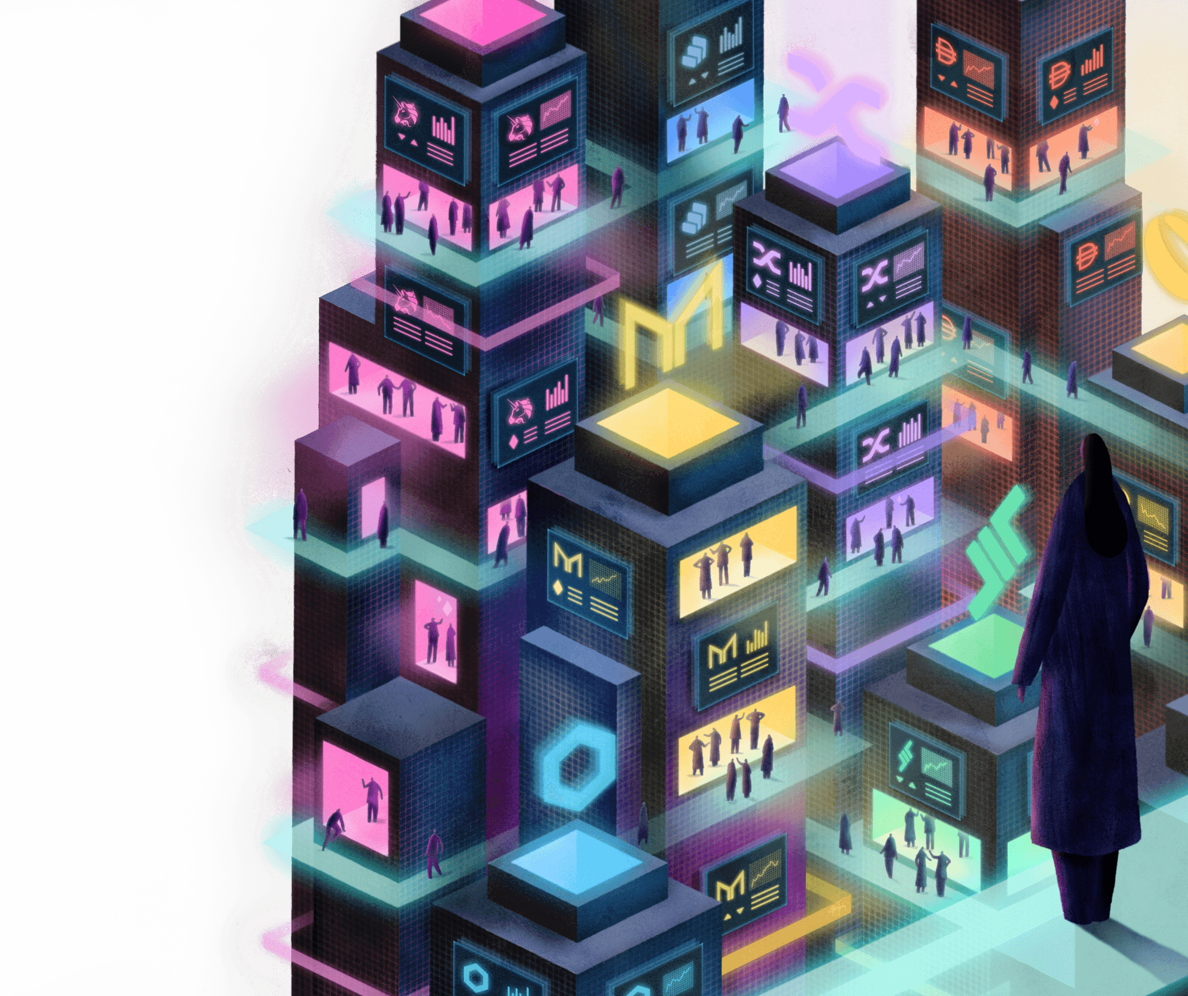
Ethereum
Ethereum is an open-source blockchain
Its cryptocurrency is Ether (ETH or Ξ)
It goes beyond just cryptocurrency…
It is fully programmable
Developers use it to build dapps:
Decentralized Finance
NFTs – metaverse + more
Games (e.g., CryptoKitties)
Notes:
Now let’s talk about Ethereum for a bit. It’s similar to Bitcoin in some ways, but there is one key difference in its design.
So what is Ethereum? It’s an open-source blockchain
It’s currency is called Ether, also ETH or its symbol here
The difference is that it goes beyond cryptocurrency… it is fully programmable
Developers can build on top of it and make dapps. Things like…
Decentralized Finance applications
NFT applications – the metaverse, token swaps, and more
There are also games like CryptoKitties

Slide 22
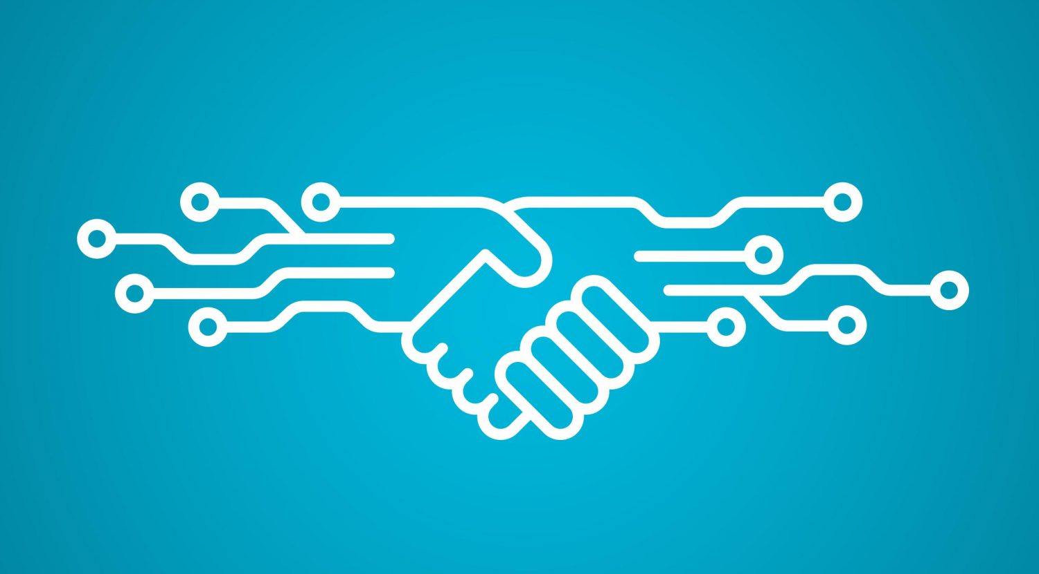
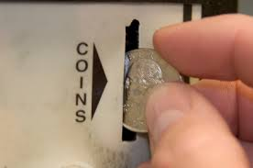

Smart Contracts & Solidity
Smart contracts are programs stored on a blockchain that run when predetermined conditions are met
They are automatically executed
Analogy: coin in a vending machine
Predictable, unambiguous, cheap (unlike the law)
Solidity is Ethereum’s language for writing smart contracts – influenced by JavaScript
Transactions cost gas – ETH fees for running on the blockchain (still cheaper than a lawyer)
Notes:
Ask the students if they what contracts are – simply put, contracts are agreements between two parties – intended to be enforceable by law
Smart contracts are a little different – they are programs that run on blockchain.
The execute automatically
Kind of like when you put a coin in a vending machine and receive a snack
The key is that they are predictable (anyone can see the code), unambiguous (same result every time), and cheap (no mental transactions or time loss). All of these things are different from normal contracts in law!
Solidity is the programming language Ethereum developers use to write smart contracts
It’s very similar to JavaScript
In the world of Ethereum, every transaction on the blockchain (aka every execution of a smart contract) costs gas – these are small ETH fees for running anything
Still much cheaper than hiring a lawyer to execute your contract for you!

Slide 23
Blockchain & Society
How does blockchain impact the world?
Notes:
Now let’s talk about some controversies surrounding blockchain – how has the technology impacted society?

Slide 24
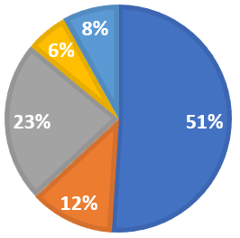

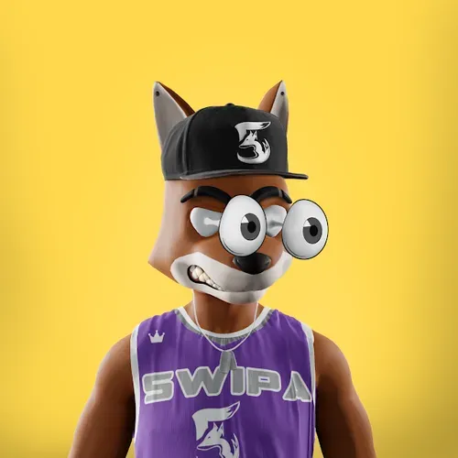


Controversy: Crime
Phishing
The Flip Side: Transparency and Auditability
It is always possible to track where assets reside – in perpetuity, forever
Users may be anonymous, but it is still possible to trace all of their transactions
51% Attack
The Power of Anonymity
The U.S. Department of Justice was able to figure out where money was stored from a Colonial Pipeline ransomware attack, and hack the address back
Rug Pulls
Illegal activity ($14 billion)
Hard to catch criminals
Notes:
Ask the students if they are aware of any crimes that have happened because of blockchain – there are some
Start with a 51% attack – if an organization could get control of 51% of the mining capabilities of a cryptocurrency, they could control it completely
It is very unlikely for this to happen in Bitcoin or Ethereum because it would require SO MUCH POWER
It can happen on smaller cryptocurrencies though
Another thing that can happen is a rug pull – when someone hypes up digital assets, like NFTS, gets people to spend money on them, and then the value goes way down
This happened with NBA player De’Aaron Fox (aka swipa the fox) – he promised big things, made 1.5 million dollars, and then swiped it all
Another thing that can happen is a phishing attack – a lot of members of the bored ape yacht club have fallen victim to this
Basically, they lost “hundreds of thousands of dollars” worth of NFTs after someone hacked their Discord and posted fake links, getting them to enter their credentials
Ask the students how the think anonymity impacts the transactions on blockchains
There is a decent amount of illegal activity – In 2021, about 14 billion dollars were sent to illicit addresses
The anonymity also makes it very difficult to catch criminals or hackers – no one even knows who founded Bitcoin, how can they find out who stole some money on it?
On the flip side, everything on the blockchain is transparent and auditable
It is always possible to track assets – and all transactions can be traced (by address)
In one instance, the US DOJ was able to track the group that stole money from Colonial Pipeline in a ransomware attack – they actually found their private key and hacked them back
https://www.investopedia.com/terms/1/51-attack.asp
https://www.sbnation.com/nba/2022/2/25/22950186/deaaron-fox-defraud-nft-swipathefox-nba-kings
https://www.coindesk.com/tech/2022/04/25/at-least-13m-in-nfts-stolen-after-bored-ape-yacht-club-instagram-discord-hacked/
https://blog.chainalysis.com/reports/2022-crypto-crime-report-introduction/
https://www.npr.org/2021/06/08/1004223000/how-a-new-team-of-feds-hacked-the-hackers-and-got-colonial-pipelines-bitcoin-bac

Slide 25

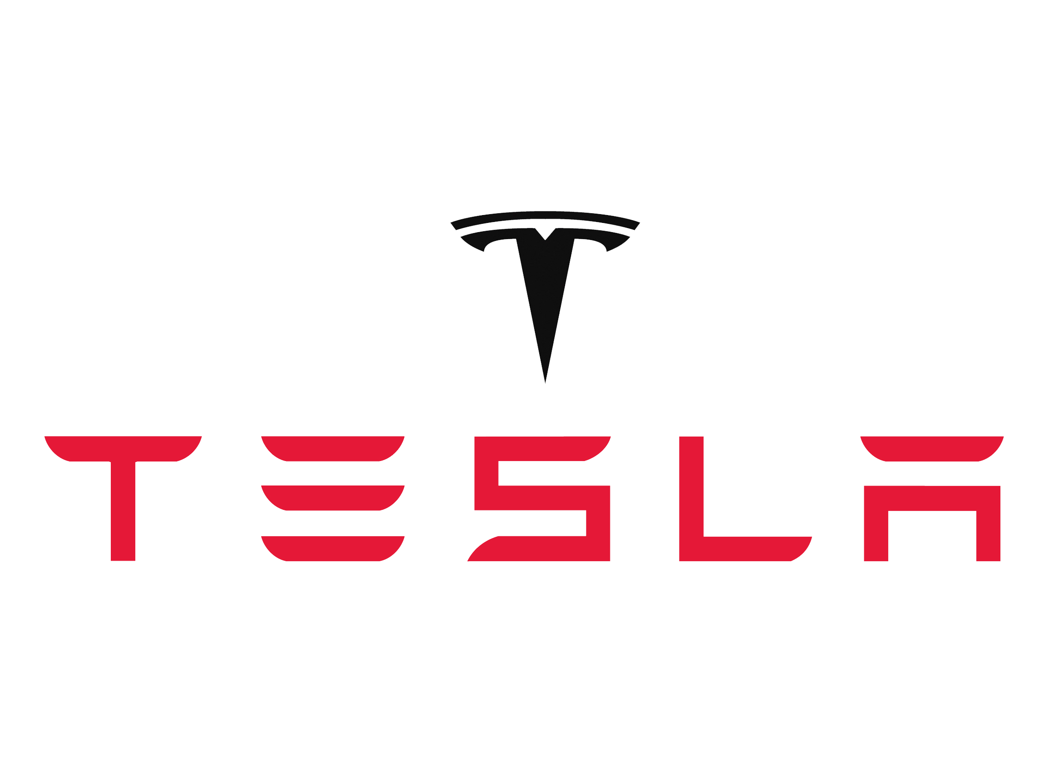

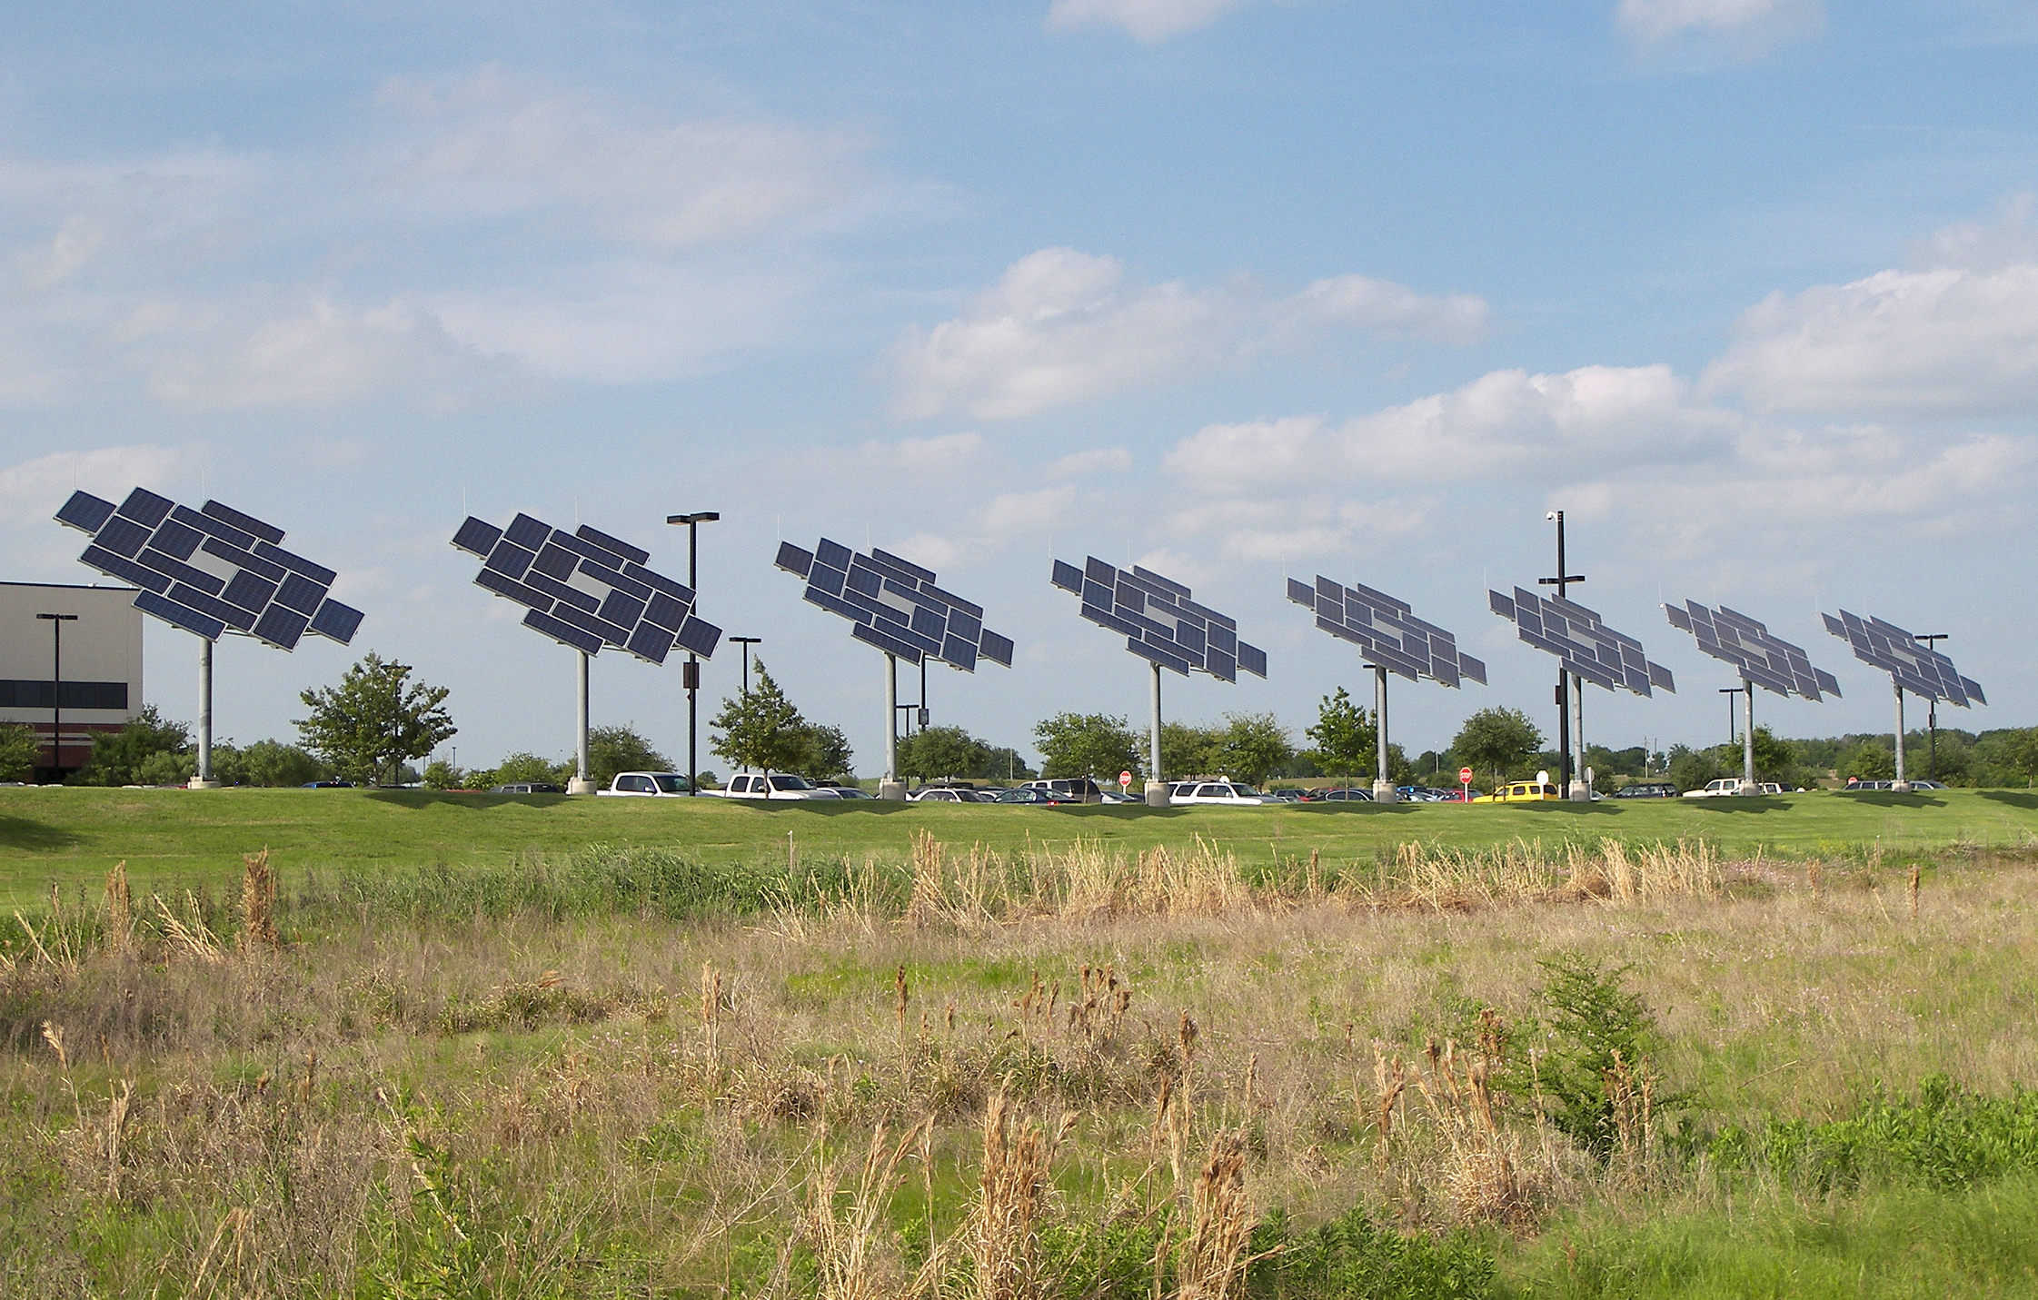

Controversy: The Environment
Tesla will not accept Bitcoin because of the environment
Mozilla stopped taking donations too
Bitcoin consumes almost 120 TWh per year
Roughly the same as a small country like Sweden
Energy Consumption ≠ Carbon Emissions
Efforts to improve: using renewable energy - solar plants in Texas
Changing methods: Ethereum moving to Proof of Stake
Notes:
Bitcoin’s price plummeted when Elon Musk announced that Tesla would no longer accept it for purchases because of its negative impact on the environment
Mozilla stopped taking donations for the same reason
So how impactful is Bitcoin, really? Well, it consumes almost 120 TerraWatt hours per year
That’s about the same amount of energy as a small country like Sweden. All of Sweden!
However… while this energy consumption is bad for the environment, the real issue is how we get that energy. Carbon emissions happen at that point
There are efforts to improve this – for example, some companies are using renewable energy (like Texas solar plants) to mine crypto
One idea is to monetize the excess energy on a network, sell bitcoin to monetize creation of the electrical grid. Turn off mining when the network needs the energy. Normalize the network load
There are also technological changes that can take place – like using different consensus algorithms. For example, Ethereum is moving from proof-of-work to proof-of-stake – this will require much less computational intensity, and therefore less energy
https://fortune.com/2021/05/12/bitcoin-plunges-elon-musk-tesla-car-purchases/
https://techcrunch.com/2022/01/06/mozilla-foundation-crypto
https://hbr.org/2021/05/how-much-energy-does-bitcoin-actually-consume
https://tech.hindustantimes.com/tech/news/bitcoin-mining-in-texas-crypto-miners-turn-to-solar-power-71649478516327.html
https://ethereum.org/en/energy-consumption/

Slide 26
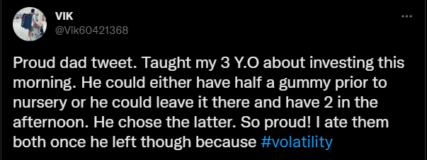

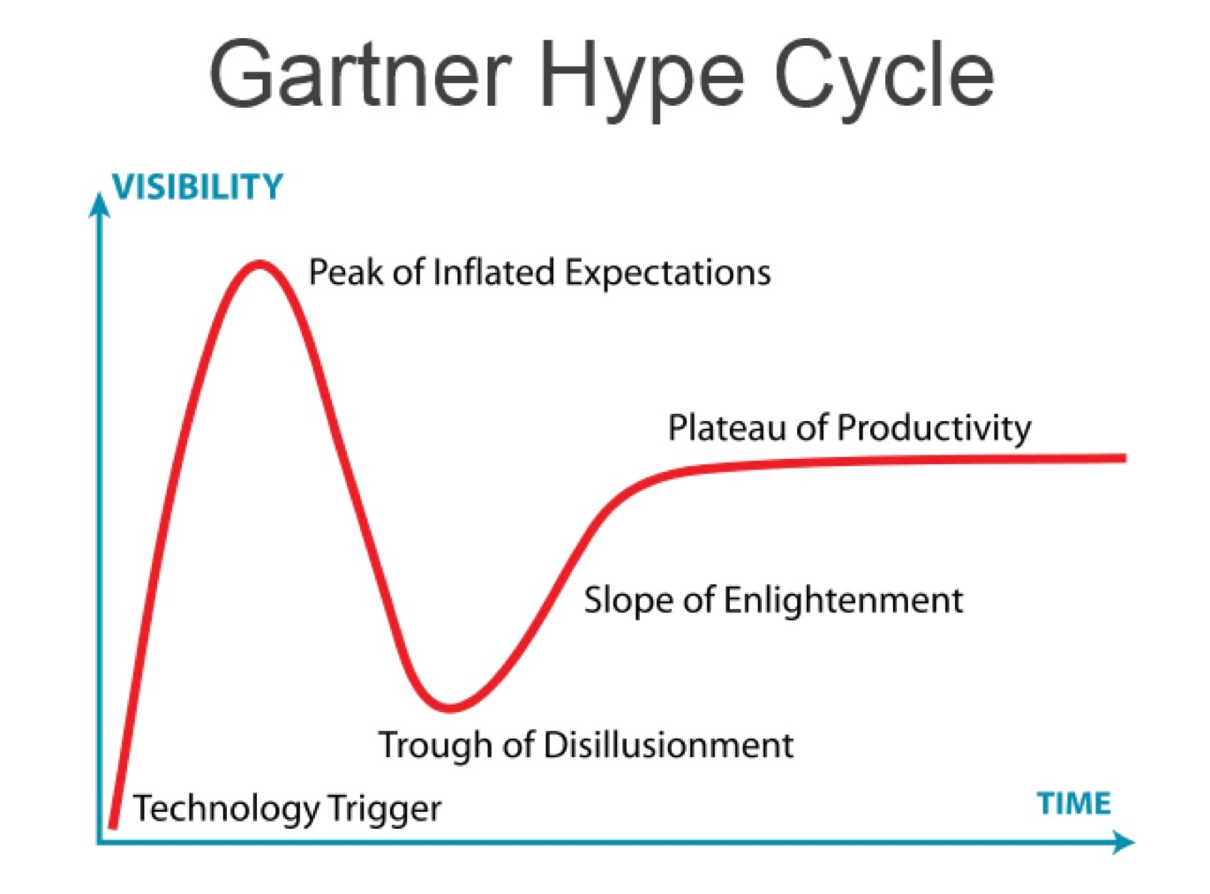
Controversy: Crypto-Bubble
“Extremely risky”
“Inherently
predatory”
The crypto market is volatile – liable to change rapidly and unpredictably
The best place to invest in crypto is in your knowledge
It is an unregulated market – good/bad
Notes:
Show the students this tweet about investing
Ask them if they know what volatility is – when something is volatile, that means it is liable to change rapidly and predictably
Wikipedia stopped taking donations in the form of cryptocurrency, calling it “extremely risky” and “inherently predatory” – just one example to show that this is a real issue
The crypto market is unregulated – ask the students if they can think of pros and cons for the lack of government regulation
All of that in consideration, show the gartner hype cycle – technology trigger, peak of inflated expectations, trough of disillusionment, slope of enlightenment, plateau of productivity: ask the students where they think blockchain is in the cycle
The big takeaway here is that the technology of blockchain is more than just cryptocurrency – it may not be a good idea to invest in bitcoin, but learning about the technology is a great thing to do. The best place to invest is in your knowledge
Proponents of blockchain say that the technology is not going away; it will be leveraged in the infrastructure layers of global computing into the future
https://twitter.com/vik60421368/status/1422461396504174592
https://finance.yahoo.com/news/extremely-risky-inherently-predatory-wikipedia-110040373.html

Slide 27
Summary
Wrapping things up
Notes:
Ask the students for some take-aways from the presentation

Slide 28
Summary
History
The first blockchain was implemented when Satoshi Nakamoto created Bitcoin in 2009 - the technology has grown into dapps, NFTs, certifications and more
Architecture
A blockchain is a digital ledger that tracks transactions on blocks, chained together and verified by a network of computers called nodes
Ethereum & Smart Contracts
Ethereum is a blockchain platform upon which developers can build dapps – made possible by smart contracts that automate execution of business logic
Controversies in Society
Controversies surrounding blockchain include the economic impacts, the environment, and its involvement in crime
Notes:
Go through a brief summary of the presentation
Blockchain all started with Bitcoin in 2009, but many use cases have arisen since then including NFTs and certifications
In its basic form, a blockchain is a digital ledger that tracks transactions on blocks, chained together and verified by a network of computers called nodes
Ethereum is a specific blockchain platform that allows developers to build dapps using smart contracts
There have been, and continue to be, several controversies surrounding the technology – but learning about it is never a bad thing

Slide 29
THANK YOU!
WHAT QUESTIONS DO YOU HAVE?

